Slide 1
Data Visualisation with Matplotlib

Slide 2
Matplotlib
We can visualise a dataset in Jupyter Notebook using Pandas and Matplotlib libraries.
Matplotlib is a python specialising in the development of two dimensional chart (including 3D charts)
Most used tool in the graphical representation of data.
The pyplot package provides classic Python interface for programming the matplotlib library.
Pyplot requires the import of Numpy package separately.
At the beginning, you need to import pyplot and rename is as plt:
import matplotlib.pyplot as plt

Slide 3
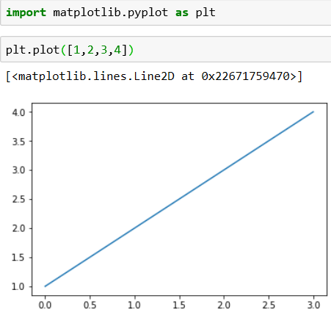
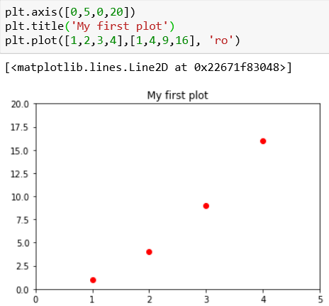
A simple Interactive Chart
Set the properties of the plot. Each pair of values(x,y) is represented by a red dot.
A simple plot: A blue line connection the points

Slide 4
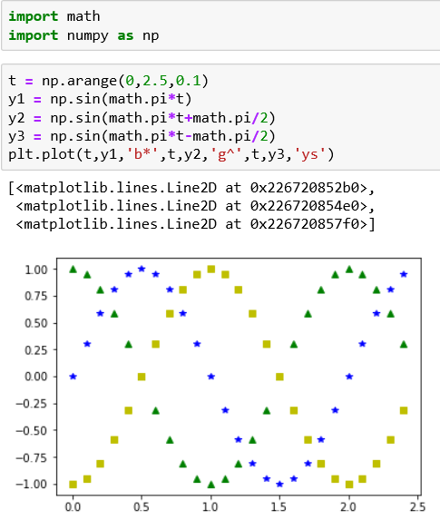
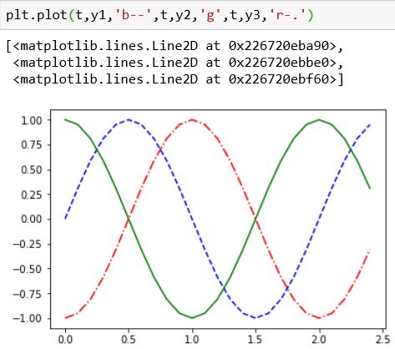
It is possible to plot three different trends in the same plots.
The example below shows three sinusoidal trends.

Slide 5
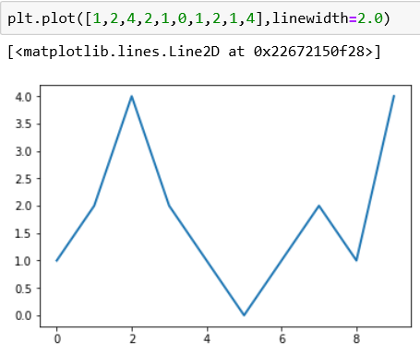
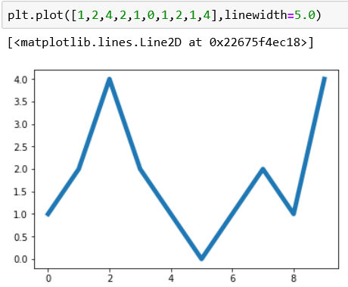
Using the kwargs
The object that makes up the chart have many attributes that characterise them. The attributes are all default values but can be set through the use of keyword args known as kwargs.
These keywords are passed as arguments to functions.
For example the thickness of a line can be changed if we set the linewidth keyword.

Slide 6
Working with Multiple Figures and Axes
Various subplots can be represented in a single figure.
The subplot() function subdivides the figure in different drawing areas. It also used to focus the commands on a specific subplot.
The argument passed to the subplot() function sets the mode of subdivision and determines which is the current subplot. The current subplot will be the only figure affected by the commands.
The subplot() function is composed of three integers.
the first number determines how many parts the figure is split into vertically
The second determines how many parts the figure is split into horizontally.
The third number selects which is the current subplot on which we can direct commands.

Slide 7
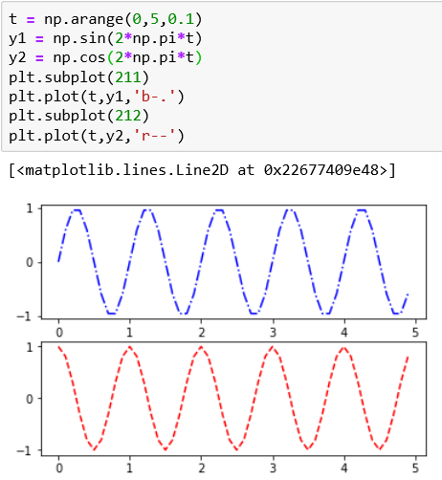
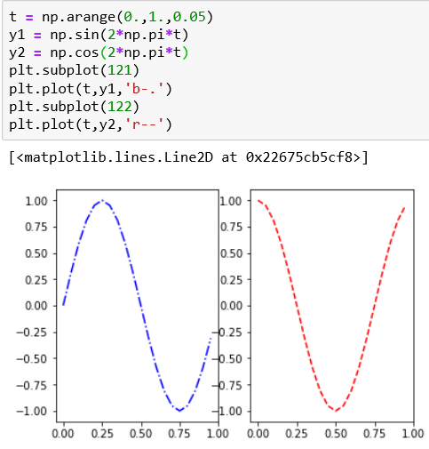
Working with Multiple Figures and Axes
Examples: two sinusoidal trends (sine and cosine)
In the first image below, the canvas is divided in two horizontal subplots with number 211 and 212 as arguments to the subplot() function.
In the second one, the canvas is divided in two vertical subplots (121 and 122)

Slide 8
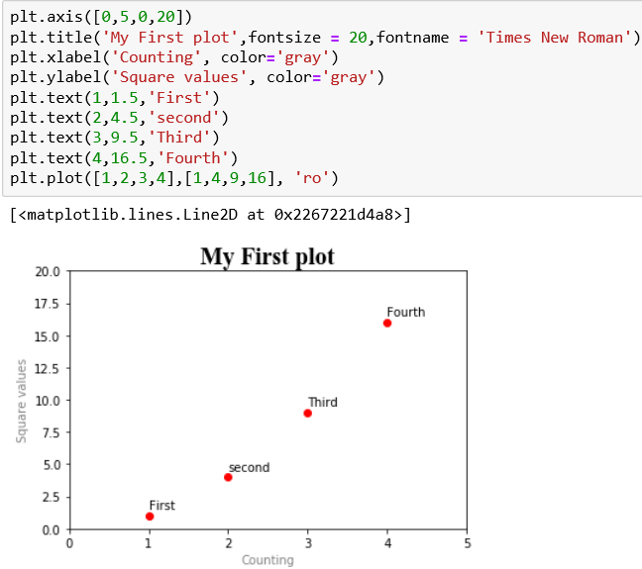
Adding a Title and Text
The text() function and the title() function

Slide 9
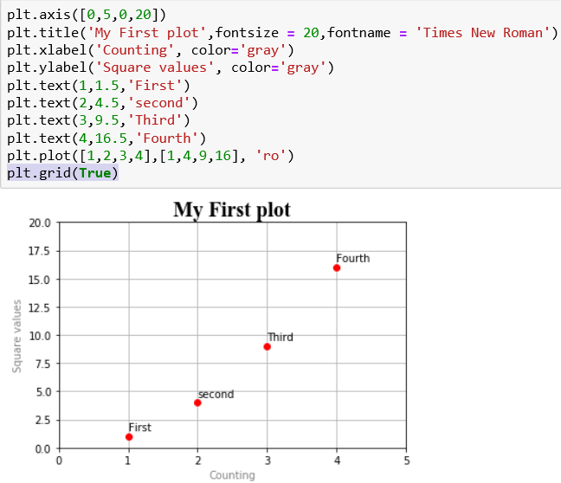
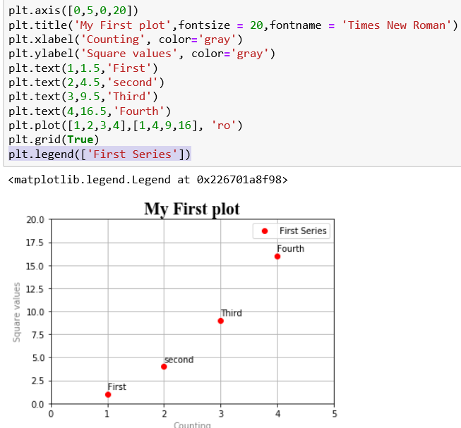
Adding a Grid and a Legend
The grid() function and legend() function

Slide 10
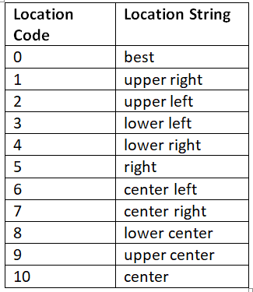
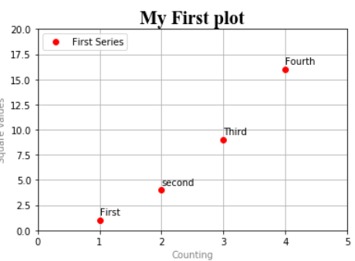
Adding a Legend
A legend is added in the upper-right corner by default.
You can use the loc keyword to change this behaviour. This can be achieved by assigning numbers from 0 to 10 to the loc kwarg. Each number characterises one of the corner of the chart and the default value is 1, the upper-right corner.
In this example, the loc kwargs was set to 2, which is upper-left

Slide 11
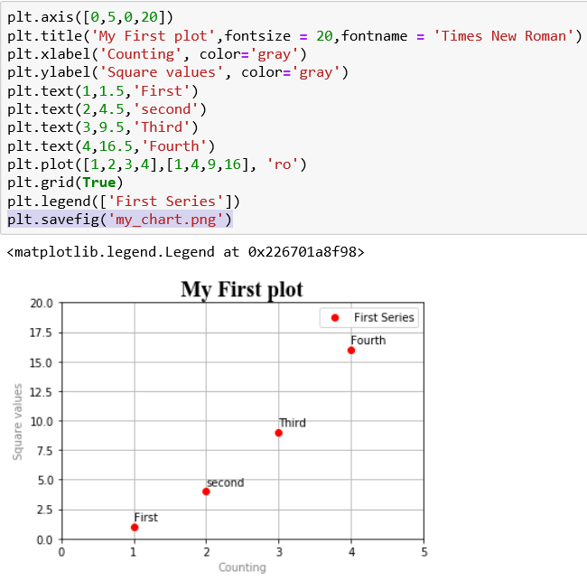
Saving charts as Image

Slide 12
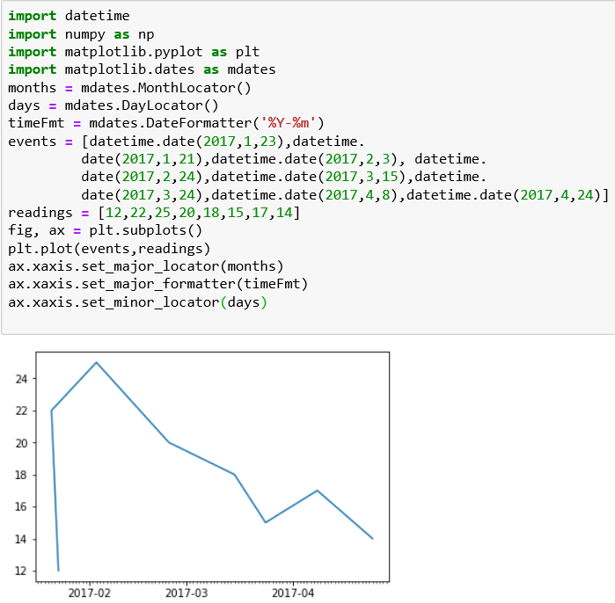
Handling Date Values

Slide 13
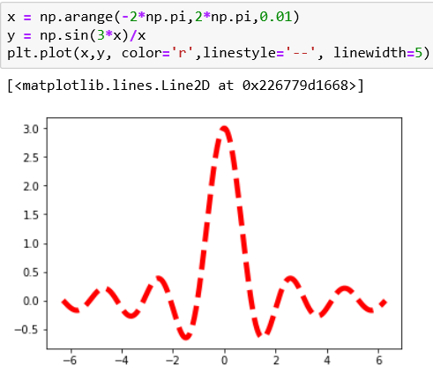
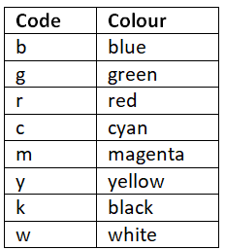
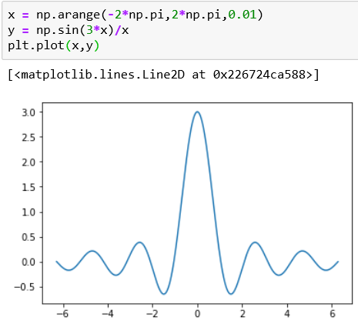
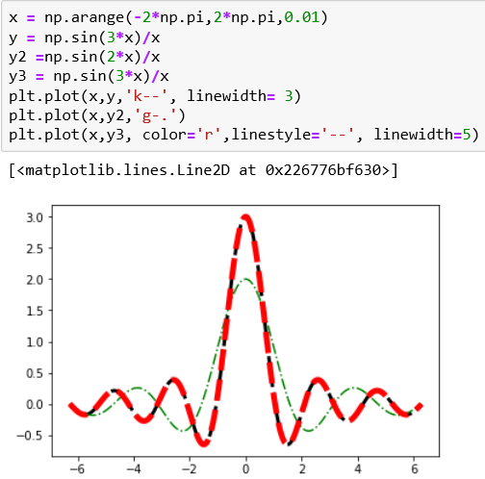
Line Charts
The simplest chart
Linear chart is a sequence of data points connected by a line.
Each point consists of a pair values(x,y)
You can use the color and linestyle kwargs to define the stroke.
The table below presents the different colour codes

Slide 14
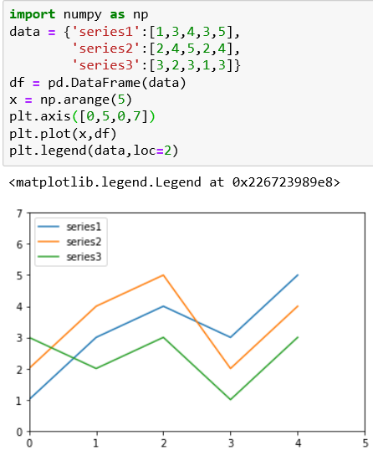
Line charts with Dataframe
The visualisation of the data in a dataframe as a linear chart is very easy.
Pass the dataframe as an argument to the plot() function to obtain a multiseries linear chart

Slide 15
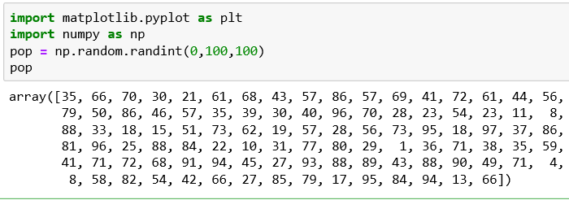
Histograms
A histogram consists of adjacent rectangles erected on the x-axis, split into discrete intervals called bins. X-axis is used to reference numerical values.
The hist()function allows you to represent a histogram.
Practical example: Let’s generate a population of 100 random values from 0 to 100 using random.randint() function as seen below.

Slide 16
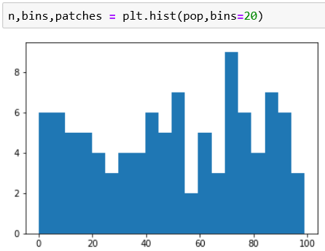
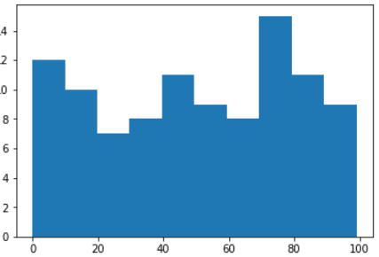
Histograms
Now we will create the histogram of these samples by passing as an argument the hist() function.
We want to divide the occurrences in 20 bins (if not specified, the default value is 10 bins)
To do that, we have to use the kwarg bin.
Default: 10 bins
8
20 bins
1
5
2
9
6
10
3
4
7
The histogram shows the number of occurrences in each bin

Slide 17
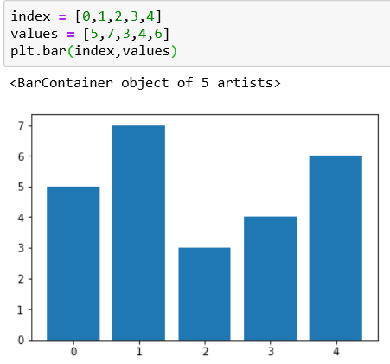
Bar Charts
Another common type of chart, similar to histogram but the x-axis is used to reference categories.
The bar() function is used to create a bar chart.
This bar chart shows that the indices are drawn on the x-axis. But because each bar corresponds to a category, it would be best if we can specify the categories through the tick label.

Slide 18
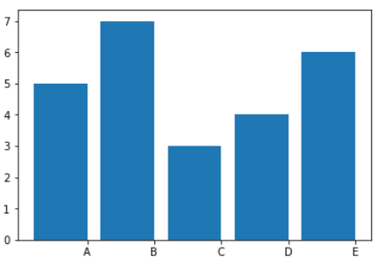

Bar Chart
The tick label is defined by a list of strings passed to the xticks() function.
For the location of the ticks, we have to pass a list containing the values corresponding to their positions on the x-axis as the first argument of the xticks() function.

Slide 19
Bar Chart – Using kwargs
We can add a specific kwarg as an argument in the bar() function.
In the next example, we add the standard deviation values of the bar through the yerr kwarg along with a list containing the standard deviations.
The kwarg is usually combined with another kwarg called error_kw, which, in turn, can be used with other kwargs such:
eColor: specifies the colour of the error bars)
capsize: defines the width of the transverse lines that mark the ends of the error bars.
The alpha kwarg indicates the degree of transparency of the coloured bar. Alpha is a value ranging from 0 to 1. When the value is 0 the object is completely transparent to become gradually more significant as it increases. When the value reaches 1, the colour is fully represented.
A legend is recommended. We use the kwarg label to identify the series we represent.

Slide 20
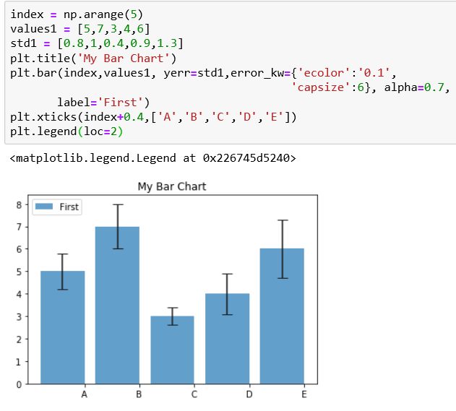
Bar Chart – Using kwargs

Slide 21
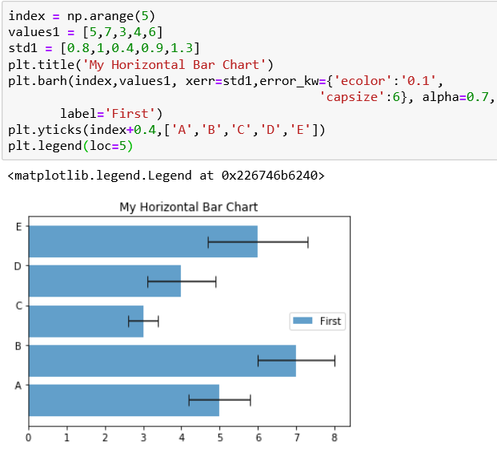
Horizontal Bar Charts
Horizontal bar chart are implemented using the barh() function.
The arguments and the kwargs valid for the bar() function remain the same for this function.
The only change is that the roles of the axes are reversed. Now the categories are represented on the y-axis and the numreical values are on the x-axis.

Slide 22
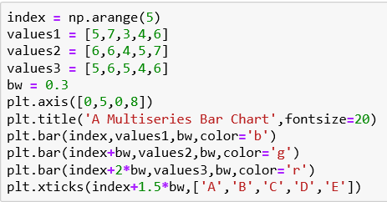
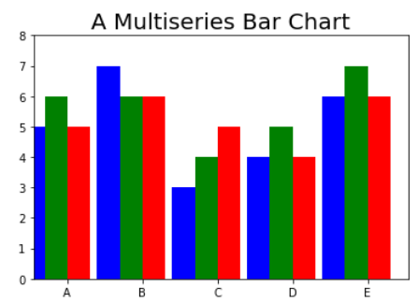
Multiseries Bar Charts
As with line charts, bar charts can be used to display larger series of values.
In a simple bar chart, each index corresponds to a bar and is assigned to the x-axis. These represents categories.
In a multiseries bar chart, the bars must share the same category.
To overcome that issue, the space occupied by an index is divided as many parts as the bars sharing that index.
It is advisable to add space which will serve as the gap to separate a category with respect to the next.

Slide 23
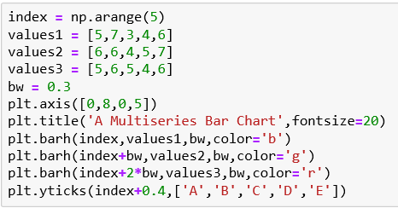
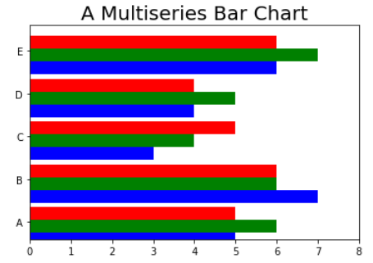
Multiseries Horizontal Bar Chart
Uses barh() function instead of bar() function.
Uses yticks() function instead of xticks() function.
Reverse the range of values covered by the axes in the axis() function.

Slide 24
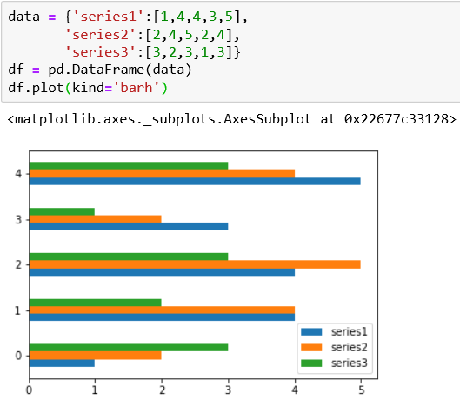
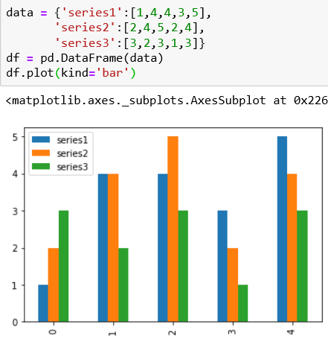
Multiseries Bar Chart with pandas Dataframe
Use the plot() function applied to the dataframe object.
Specify inside a kwarg called kind to which you have to assign the type of chart you want to represent, which in this case is bar for vertical bar chart and barh for a horizontal bar chart.

Slide 25
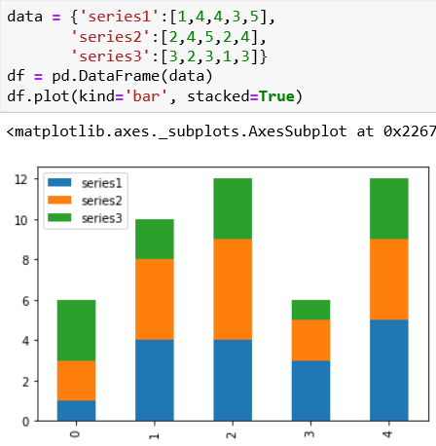
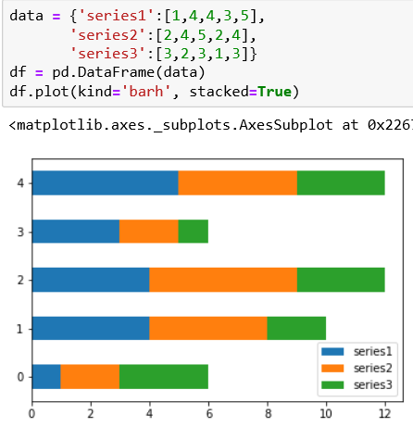
Stacked Bar Chart with pandas Dataframe
Use a kwarg called stacked

Slide 26
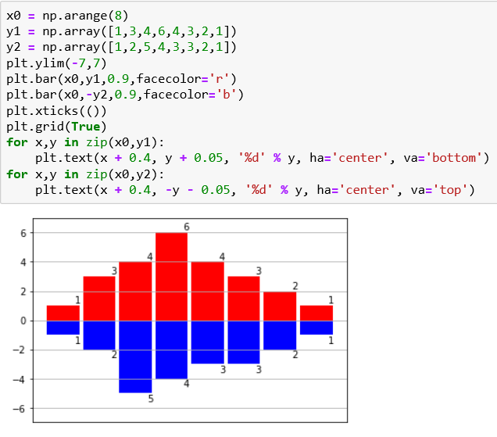
Other Bar Chart
In this example, you want to represent one of the two series in a negative form.
Use the facecolor kwargs to colour the inner colour of the bar in a different way.
In order to add the y value with a label at the end of each bar (good for readability), you can use a for loop in which the text() function will show the y value.
You can adjust the label position using the ha and va, which control the horizontal and vertical alignment.

Slide 27
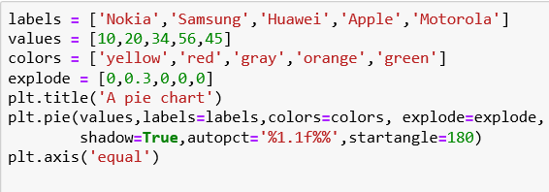
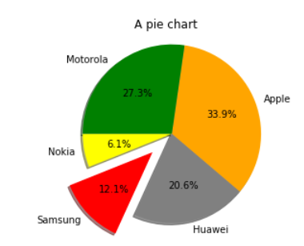
Pie chart
Use the pie() function to inherently calculate the percentage occupied by each value.
Use the explode kwarg to highlight a slice. E.g. Samsung
Use the title() function to add a title
Set the axis() function at end to ‘equal’ to have a perfectly spherical pie chart.
User the startangle to adjust the rotation of the pie. It takes an integer value between 0 and 360 which are the degree of rotation. (0 is the default)
Use the autopct kwarg to add to the center of each slice a text label showing the corresponding value.
Use the shadow kwarg to add a shadow to an image by setting it to True.

Slide 28
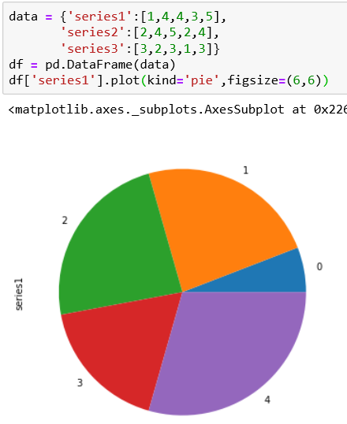
Pie chart with a pandas Dataframe
The pie chart can only represent one series at a time.
In this example, we display only the values of the first series by specifying df[‘series1’].
The kind kwarg is used to specify the type of chart in the plot() function.
To represent a perfectly circular pie chart, we use the figsize kwarg

Slide 29
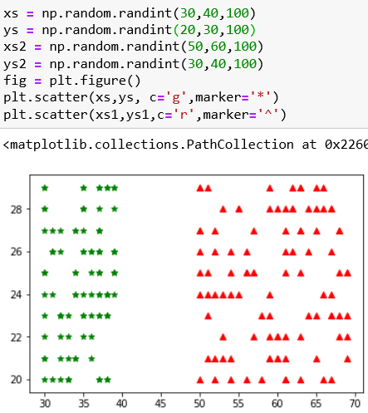
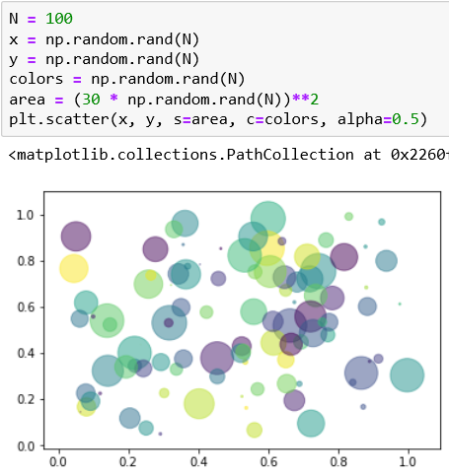
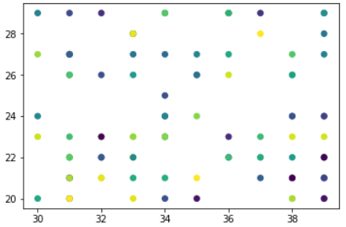
Scatter Plot
Scatter() function can be used to create scatter plots where the properties of each individual point (size, face color, edge color, etc.) can be individually controlled or mapped to data.

Slide 30
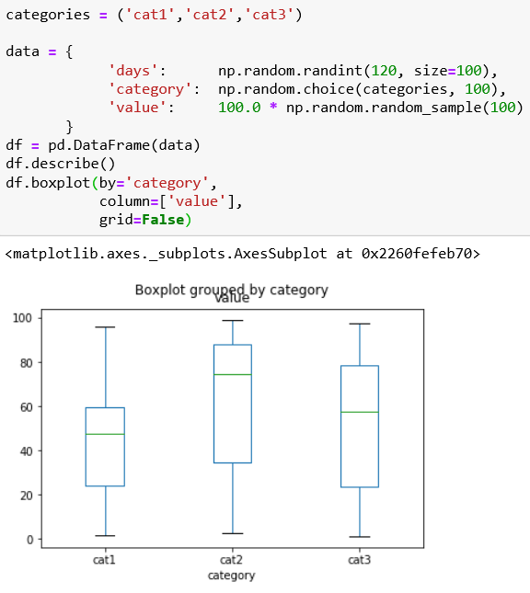
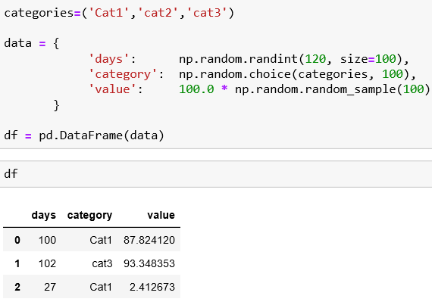
Box Plots

Slide 31
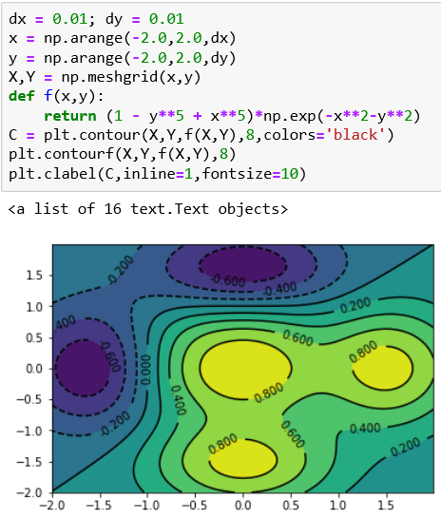
Advanced chart – Contour plot
Contour plot or contour map is suitable for displaying three-dimensional surfaces.
You need to z =f(x,y) for generating a three-dimensional surface.
Define a range of values for x,y that will define the area of the map to be displayed.
Then calculate the z values for each pair (x,y), applying the function f(x,y) in order to obtain a matrix of z values.
Finally, use the contour() function to generate the contour of the map.
Areas delimited by the curves of level are filled by a colour gradient, defined by a colour map. For example negative values can indicate dark shades of blue and move to yellow and then red with the increase of positive values.

Slide 32
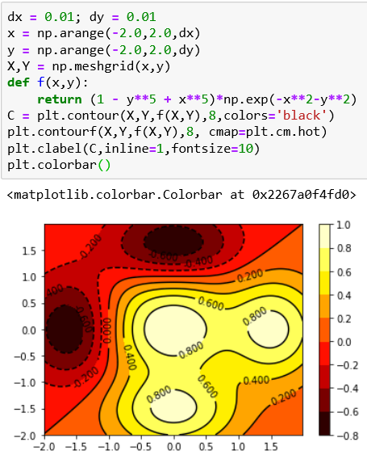
Advanced chart – Contour plot
You can choose among a large number of color map available by specifying them with the cmap kwarg.
Same example as previous with the ‘hot’ color map gradient.
To add a colour scale as a reference by the side of the graph, use the colorbar() function.

Slide 33
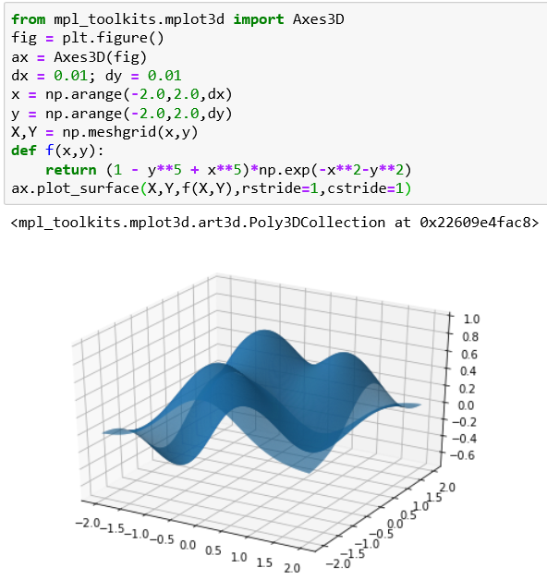
Using mplot3d Toolkit for 3D Surfaces
The mplot3d toolkits is included in all standard installation of matplotlib and allows us to extend the capabilities of visualisation to 3D data.
We use an object called Axes3D
from mpl_toolkits.mplot3d import Axes3D
In this example, we use the same function: z =f(x,y)used for contour map
Once we have calculated the meshgrid, we can view the surface with the plot_surface() function.

Slide 34
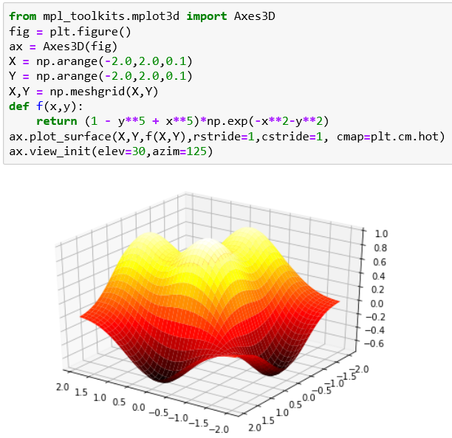
Using mplot3d Toolkit for 3D Surfaces
Use cmap kwarg to change the color. Rotate the surface by using the view_init() function.
The elev kwarg adjust the height at which the surface is seen and the azim kwarg adjusts the angle of rotation of the surface.
In this example, the 3D surface is rotated and observed from a higher viewpoint.

Slide 35
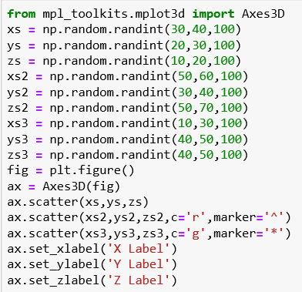
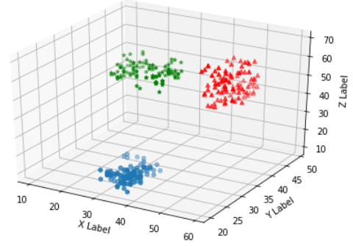
Scatter Plots in 3D
The most used among all 3D views is the 3d scatter plot. With this type of visualisation, you can identify if the points follow particular trends and if they tend to cluster.
We use the scatter() function as the 2D case but applied on the Axes3D object. By doing this, we can visualise different series all together in the same 3D representation.

Slide 36


Subplots Within Other subplots
Since we are talking of frames (i.e. Axes objects), we need to separate the main Axes (i.e., the general chart) from the frame we want to add that will need another instance of Axes.
To do this we use the figure() function to get the Figure object on which we define two different Axes objects using the add_axes() function

